Slide 1

EIS Updates!
Brought to you by Cool Crab

Slide 2
Topics Today
LDAP Query User Roll Over
Extension Attribute Update
Group Management
A Little PowerShell
Ceph Update

Slide 3
LDAP Query User
Currently using:
LDAPQueryUser3
Date to Remember:
1/1/2022
LDAPQueryUser1 is available to convert Today!

Slide 4

Extension Attribute Update
Currently PDIM & W# are located at extensionAttribute1 & extensionAttribute2
AccountMaint populates EmployeeID and EmployeeNumber
Action Item –
Remap your LDAP Apps
Why?
We need those ExtensionAttributes cleared!

Slide 5
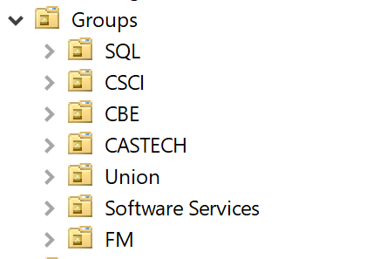
Groups!
Lots of Groups, very few Members
Plan
Sub Organizational Units under “Groups”
Move / updated / remove groups from Hosts to Groups

Slide 6

A Little PowerShell + Native Tools
Two Tools, working together:
RSAT & PowerShell 7
The RSAT “You Need”
Get-WindowsCapability -Name Rsat.ActiveDirectory.DS-LDS.Tools~~~~0.0.1.0 -Online | Add-WindowsCapability –Online
PowerShell 7
Available from GitHub, Microsoft Store, or Chocolatey
PSReadline Beta -> https://devblogs.microsoft.com/powershell/announcing-psreadline-2-2-beta-2-with-dynamic-help/
Demo Time!

Slide 7
P Drive and Ceph
All about Samba Configurations
Next Steps
Ceph “Style Guide”
Many individual shares with tightly scoped permissions
Moving away from a small number of shares with broadly scoped permissions
Challenges:
UUID Mapping
Domain Users “Stamping”

